Slide 1

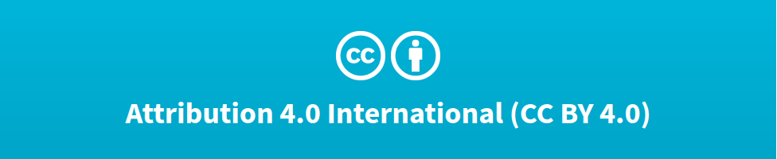

Deep Learning Design Patterns with Tensorflow 2.x
Computer Vision Workshop - Mobile Convolutional Networks Version: Feb 2020
Repo: github.com/GoogleCloudPlatform/keras-idiomatic-programmer
twitter.com/andrewferlitsch

Slide 2
Mobile Convolutional Networks
Overview
We will cover in this section the design of SOTA mobile convolutional networks.
MobileNet V1/V2 - latency vs, size tradeoff hyperparameters
SqueezeNet - introduced the fire module and concept of macro and micro architecture and metaparameters.
ShuffleNet - introduced the concept of channel shuffle.

Slide 3
MobileNet V1
MobileNet v1 is an architecture introduced by Google in 2017 for producing smaller networks which can fit on mobile and IoT devices, while maintaining accuracy close to their larger network counterparts.
The MobileNet v1 architecture replaces normal convolutions with depth wise separable convolutions to further reduce computational complexity.

Slide 4
MobileNet V1 - Architecture
The MobileNet v1 architecture incorporated several design principles for constrained memory devices:
An additional parameter (resolution multiplier) for more aggressive reduction in feature map sizes.
An additional parameter (width multiplier) for more aggressive reduction in the number of feature maps.
Using depth wise convolutionals (as in Xception) to reduce computational complexity while maintaining representational equivalence.
The classifier component uses a convolutional layer in place of a dense layer for final classification.

Slide 5
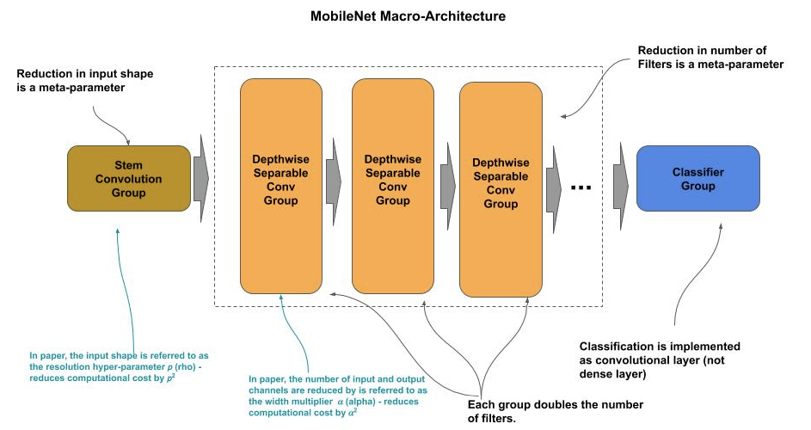
MobileNet V1 - Architecture

Slide 6
MobileNet V1 - Architecture
Width Multiplier
The width multiplier α (alpha), which thins a network uniformly at each layer.
At each layer, the number of input channels is αM and the number of output channels is αN, where M and N are the number of channels (feature maps) of a non-thinned MobileNet.
The value of α (alpha) is between 0 and 1, and will reduce the computational complexity of a MobileNet by α (alpha)**2 (i.e., the number of parameters). A value of α < 1 is referred to as a reduced MobileNet. Typically values are 0.25 (6% of non-thinned), 0.50 (25%), and 0.75 (56%).
In tests results reported in the paper, a non-thinned MobileNet-224 had a 70.6% accuracy on ImageNet with 4.2 million parameters and 569 million matrix multi-add operations, while a 0.25 (width multiplier) mobilenet-224 had 50.6% accuracy with 0.5 million parameters and 41 million matrix multi-add operations.

Slide 7
MobileNet V1 - Architecture
Resolution Multiplier
The second metaparameter introduced was the resolution multiplier ρ (rho), which thins the input shape and consequently the feature map sizes at each layer.
The value of ρ (rho) is between 0 and 1, and will reduced computational complexity of a mobile net by ρ (rho)**2.
In tests results reported in the paper, a 0.25 (resolution multiplier) mobilenet-224 had 64.4% accuracy with 4.2 million parameters and 186 million matrix multi-add operations.

Slide 8
MobileNet V1 - Architecture
Below is a skeleton template for a MobileNet-224. Note the use of parameters alpha and rho for the width and resolution multiplier.
def stem(inputs, alpha): """ Construct the stem group inputs : input tensor alpha : with multiplier """ # REMOVED for brevity return outputs def learner(inputs, alpha): """ Construct the learner group inputs : input to the learner alpha : with multiplier """ # REMOVED for brevity return outputs
def classifier(inputs, alpha, dropout, n_classes): """ Construct the classifier group inputs : input to the classifier alpha : with multiplier Dropout: percent of dropout n_classes: number of output classes """ # REMOVED for brevity return outputs # Construct the model inputs = Input((224*rho, 224*rho, 3)) outputs = stem(inputs, alpha) outputs = learner(outputs, alpha) outputs = classifier(outputs, alpha, dropout, n_classes) model = Model(inputs, outputs)

Slide 9
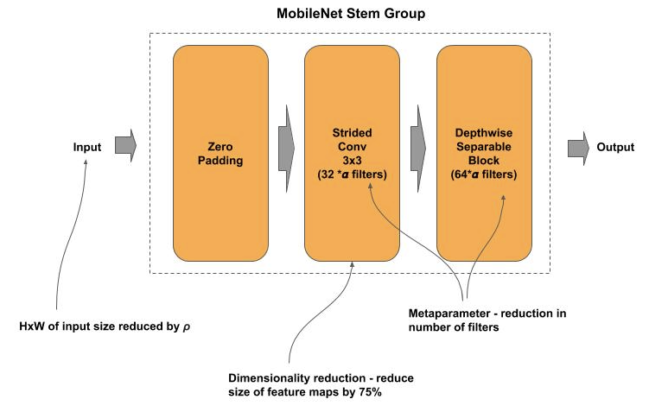
MobileNet V1 - Stem
The stem component consists of a strided 3x3 convolution (feature pooling) followed by a single depthwise separable block of 64 filters. The number of filters in both the strided convolution and the depthwise block are further reduced by the hyperparameter α (alpha).
The reduction of the input size by the metaparameter ρ (rho) is not done in the model, but upstream in the input preprocessing function.

Slide 10
MobileNet V1 - Stem
Below is an example implementation of the stem component.
def stem(inputs, alpha): """ Construct the stem group inputs : input tensor alpha : with multiplier """ # Convolutional block x = ZeroPadding2D(padding=((0, 1), (0, 1)))(inputs) x = Conv2D(32 * alpha, (3, 3), strides=(2, 2), padding='valid')(x) x = BatchNormalization()(x) x = ReLU(6.0)(x) # Depthwise Separable Convolution Block x = depthwise_block(x, 64, alpha, (1, 1)) return x
Note that a post-activation batch normalization (Conv-BN-RE) is used for convolutional layers.
Note how the ReLU in the above example takes an optional parameter with the value of 6.0. This is the max_value argument to ReLU which defaults to None. It’s purpose is to clip any value above max_value. Thus in the above examples, all the outputs will be in the range of 0 to 6.0. It is a general practice to clip the output from ReLU in mobile networks, if the weights are later quantized (low-precision computation). It’s been found that quantized models maintain better accuracy when the output from a ReLU has a constrained range. The general practice is to set it to 6.0.

Slide 11
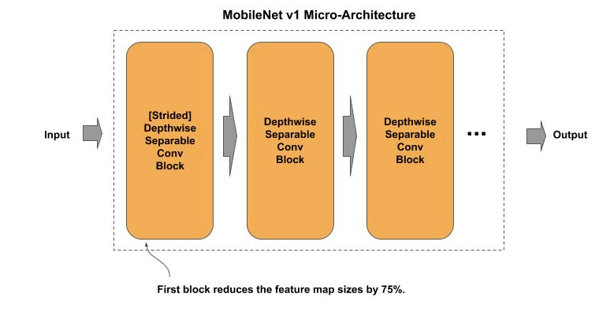
MobileNet V1 - Learner
The learner component in the MobileNet-224 consists of four groups, where each group consists of two or more convolutional blocks. Each group will double the number of filters from the preceding group, and the first block in each group uses a strided convolution (feature pooling) to reduce the feature map sizes by 75%.

Slide 12
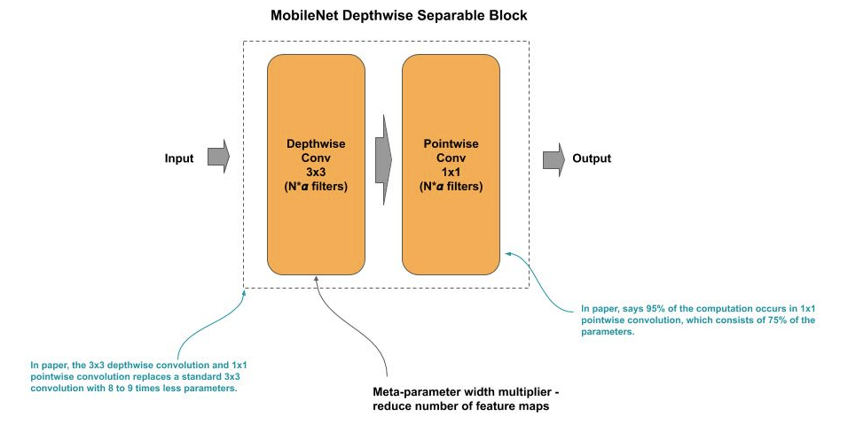
MobileNet V1 - Block
Below is a depiction of a MobileMet convolutional block, which consists of a depthwise 3x3 convolution followed by the 1x1 pointwise convolution; whereby the number of output filters is further reduced by the hyperparameter α (alpha).

Slide 13
MobileNet V1 - Block
Below is an example implementation of a depthwise separable convolutional block:
def depthwise_block(x, n_filters, alpha, strides): # Apply the width filter to the number of feature maps filters = int(n_filters * alpha) # Strided convolution to match number of filters if strides == (2, 2): x = ZeroPadding2D(padding=((0, 1), (0, 1)))(x) padding = 'valid' else: padding = 'same' # Depthwise Convolution x = DepthwiseConv2D((3, 3), strides, padding=padding)(x) x = BatchNormalization()(x) x = ReLU(6.0)(x) # Pointwise Convolution x = Conv2D(filters, (1, 1), strides=(1, 1), padding='same')(x) x = BatchNormalization()(x) x = ReLU(6.0)(x) return x

Slide 14
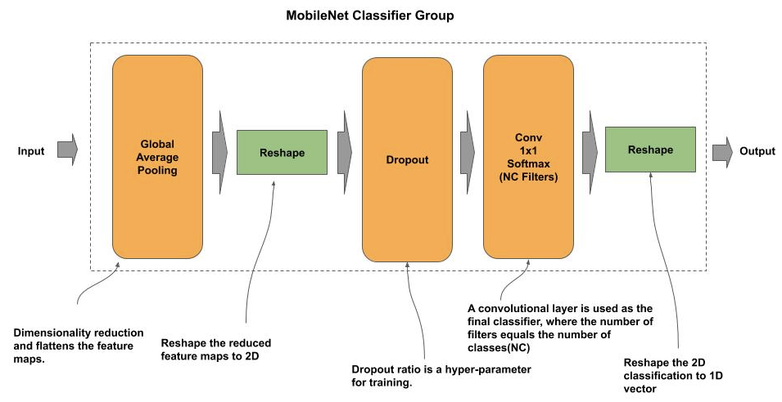
MobileNet V1 - Classifier
GlobalAveragePooling2D layer to flatten the feature maps and reduce them high dimensional encoding to a lower dimensional encoding (i.e., 1x1 pixel per feature map).
This is then followed by a Reshape layer to reshape the 1D vector for a 2D convolution with a softmax activation and where the number of filters is the number of classes.
This is then followed by another Reshape to reshape the output back to a 1D vector (one element per class). The classifier also contains a Dropout layer for regularization.

Slide 15
MobileNet V1 - Classifier
Below is an example implementation of the classifier component:
def classifier(x, alpha, dropout, n_classes): """ Construct the classifier group x : input to the classifier alpha : width multiplier dropout : dropout percentage n_classes : number of output classes """ # Flatten the feature maps into 1D feature maps (?, N) x = GlobalAveragePooling2D()(x) # Reshape the feature maps to (?, 1, 1, 1024) shape = (1, 1, int(1024 * alpha)) x = Reshape(shape)(x) # Perform dropout for preventing overfitting x = Dropout(dropout)(x) # Use convolution for classifying (emulates a fully connected layer) x = Conv2D(n_classes, (1, 1), padding='same', activation='softmax')(x) # Reshape the resulting output to 1D vector of number of classes x = Reshape((n_classes, ))(x) return x

Slide 16
MobileNet V2
MobileNet v2 is an architecture introduced by Google in 2018 as further improvements to v1; whereby the authors stated that the redesign further reduced computational complexity while preserving representational power with increased accuracy for mobile and IoT devices that are memory constrained. The MobileNet v2 architecture replaces convolutional blocks with inverted residual blocks to improve performance.

Slide 17
MobileNet V2 - Architecture
The MobileNet v2 architecture incorporated several design principles for constrained memory devices:
Continued with the use of the metaparameter (alpha) as a width multiplier, as in v1.
Continued using depth wise separable convolutions in place of normal convolutions, as in v1.
Replaced using convolutional blocks with residual blocks.
Introduced a new novel design for residual blocks, the authors called inverted residual blocks.
Replaced using 1x1 nonlinear convolutions with 1x1 linear convolutions.

Slide 18
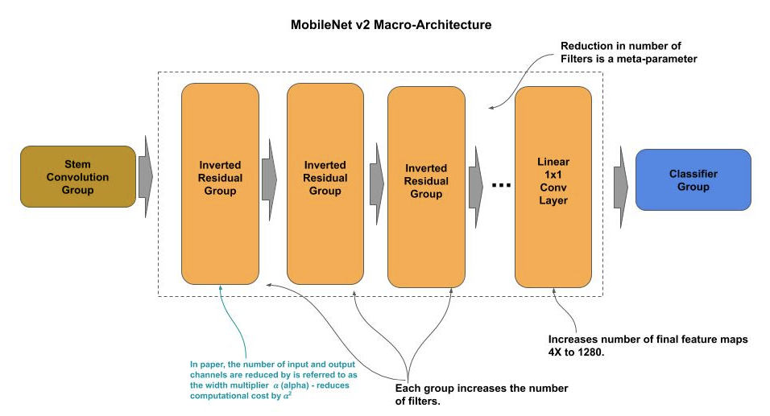
MobileNet V2 - Architecture
In the macro-architecture, the learner component consists of four inverted residual groups, followed by a 1x1 linear convolution (i.e., activation function is linear).

Slide 19
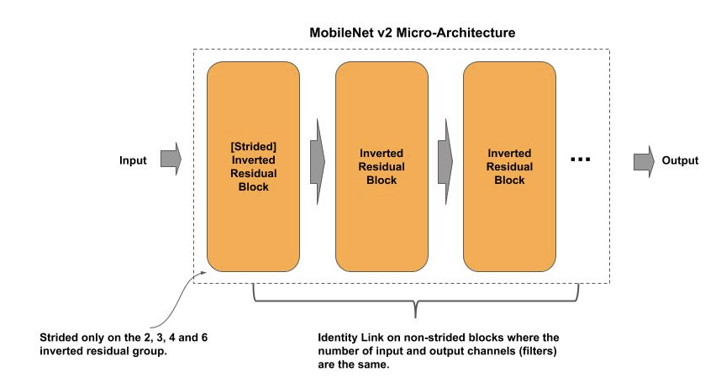
MobileNet V2 - Learner
The learner component consists of seven inverted residual groups, followed by a 1x1 linear convolution. Each inverted residual group consists of two or more inverted residual blocks, where each group progressively increases the number of filters (output channels). Each group starts with a strided convolutional, reducing the size of the feature maps (channels) as each group progressively increases the number of feature maps.

Slide 20
MobileNet V2 - Learner
Below is an example implementation of a MobileNet v2 group:
def group(x, n_filters, n_blocks, alpha, expansion=6, strides=(2, 2)): """ Construct an Inverted Residual Group x : input to the group n_filters : number of filters n_blocks : number of blocks in the group alpha : width multiplier expansion : multiplier for expanding the number of filters strides : whether first inverted residual block is strided. """ # In first block, the inverted residual block maybe strided x = inverted_block(x, n_filters, alpha, expansion, strides=strides) # Remaining blocks for _ in range(n_blocks - 1): x = inverted_block(x, n_filters, alpha, expansion, strides=(1, 1)) return x

Slide 21
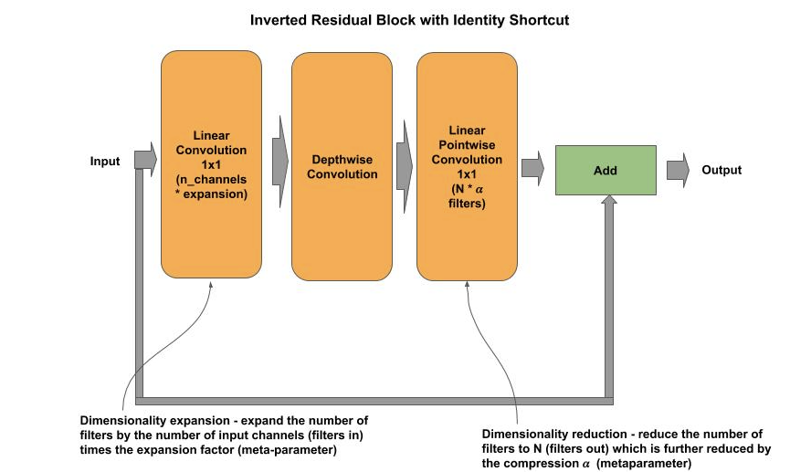
MobileNet V2 - Block
The block is referred to as an inverted residual block because it reverses (inverts) the relationship of the dimensionality reduction and expansion surrounding the middle convolution layer from a conventional residual block.
That is, instead of starting with a 1x1 bottleneck convolution for dimensionality reduction and ending with a 1x1 linear projection convolution for dimensionality restoration, the order is reversed.
MobileNet v2 introduces a new hyperparameter expansion for the initial 1x1 linear convolution which performs the dimensionality expansion.

Slide 22
MobileNet V2 - Block
Below is an example implementation of an inverted residual block:
# Strided convolution to match number of filters if strides == (2, 2): x = ZeroPadding2D(padding=((0, 1), (0, 1)))(x) padding = 'valid' else: padding = 'same' # Depthwise Convolution x = DepthwiseConv2D((3, 3), strides, padding=padding)(x) x = BatchNormalization()(x) x = ReLU(6.)(x) # Linear Pointwise Convolution x = Conv2D(filters, (1, 1), strides=(1, 1), padding='same')(x) x = BatchNormalization()(x) # Number of input filters matches the number of # output filters if n_channels == filters and strides == (1, 1): x = Add()([shortcut, x]) return x
def inverted_block(x, n_filters, alpha, expansion=6, strides=(1, 1)): # Remember input shortcut = x # Apply the width filter to the number of feature maps for the # pointwise convolution filters = int(n_filters * alpha) n_channels = int(x.shape[-1]) # Dimensionality Expansion (non-first block) if expansion > 1: # 1x1 linear convolution x = Conv2D(expansion * n_channels, (1, 1), padding='same')(x) x = BatchNormalization()(x) x = ReLU(6.)(x)

Slide 23
SqueezeNet
SqueezeNet is an architecture introduced by joint research of DeepScale and UC Berkeley and Stanford University in 2015. In the corresponding paper, the authors introduced a new type of module, referred to as the fire module, and introduced terminology for microarchitecture, macroarchitecture and metaparameters.

Slide 24
SqueezeNet
In the corresponding paper on SqueezeNet, the authors describe their design principles to achieve their objectives, which they referred to as strategy 1, 2 and 3:
Strategy 1: Use mostly 1x1 filters instead of the more common convention of 3x3 filters, which give a 9X reduction in the number of parameters. The v1.0 version of SqueezeNet used a 2:1 ratio of 1x1 to 3x3 filters.
Strategy 2: Reduce the number of input filters to the 3x3 layers to further reduce the number of parameters. They refer to this component of the fire module as the squeeze layer.
Strategy 3: Delay downsampling of feature maps to as late as possible in the network, in contrast to the convention of the time to downsample early to preserve accuracy, by using a stride of 1 on the early convolution layers and delay using stride of 2, which are strided convolutions which perform feature map downsampling.

Slide 25
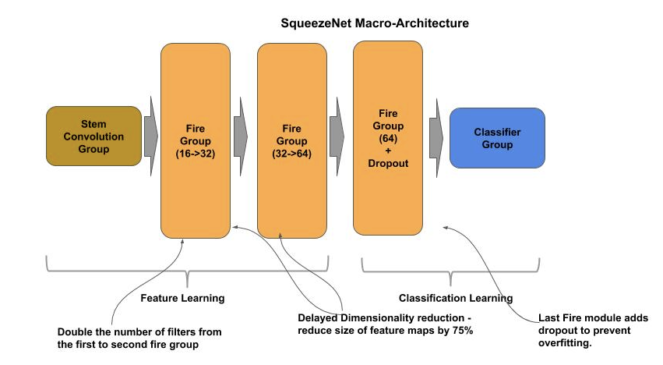
SqueezeNet - Architecture
The SqueezeNet architecture consists of a stem group, three fire groups consisting of a total of eight fire blocks (referred to as modules in paper) and a classifier.

Slide 26
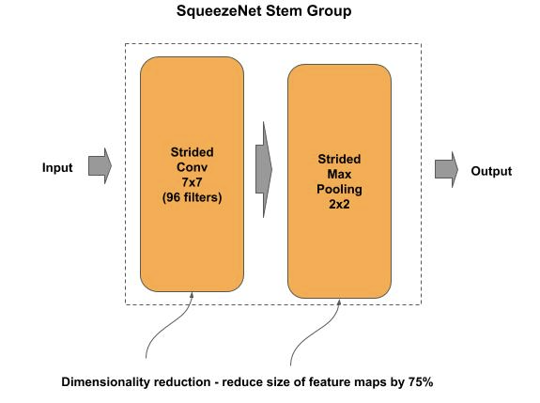
SqueezeNet - Stem
The stem component uses a coarse level 7x7 convolutional layer along with aggressive feature map size reduction, where the convolutional layer is strided (feature pooling), followed by a max pooling layer, resulting in a 94% (0.25 * 0.25) reduction from the input size.

Slide 27
SqueezeNet - Learner
The learner consists of three fire groups:
The first fire group has an input of 16 filters (channels) and an output of 32 filters (channels).
The second fire group doubles that with input of 32 filters (channels) and output of 64 filters (channels). Both groups delay downsampling of the feature maps to the end of the group with a MaxPooling2D layer.
The third fire group is a single fire block of 64 filters followed by a dropout layer.

Slide 28
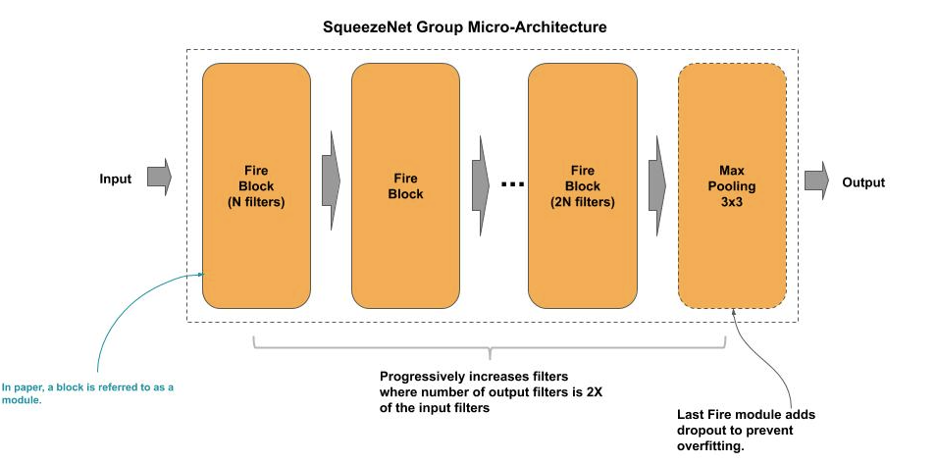
SqueezeNet - Learner

Slide 29
SqueezeNet - Group
Below is an example implementation for the first and second (non-last) fire group.
def group(x, filters): ''' Construct a Fire Group x : input to the group filters: list of number of filters per fire block (module) ''' # Add the fire blocks (modules) for this group for n_filters in filters: x = fire_block(x, n_filters) # Delayed downsampling x = MaxPooling2D((3, 3), strides=(2, 2))(x) return x

Slide 30
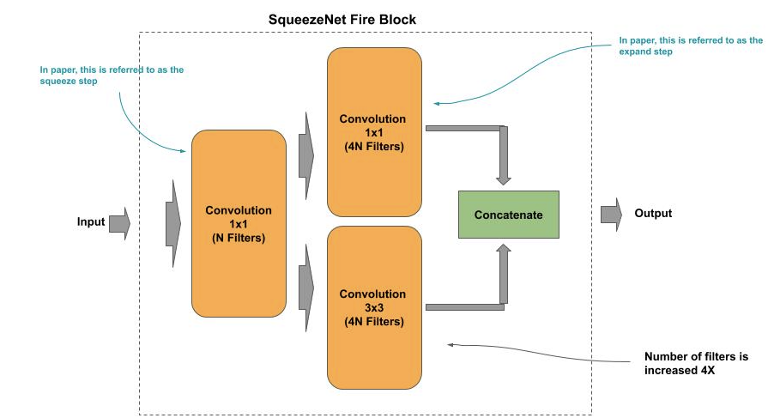
SqueezeNet - Block
The fire block consists of two convolutional layers, where the first layer is the squeeze layer and the second layer is the expand layer.
The squeeze layer uses a 1x1 bottleneck convolution, which is a 1x1 convolution with a stride of 1 to preserve the size of the feature maps (i.e., no downsampling), and reduce the number of filters passed to the expand layer.
The expand layer is a branch of two convolutions, a 1x1 linear projection convolution and a 3x3 convolution. The outputs (feature maps) from the convolutions are then concatenated. The expand layer expands the number of feature maps by a factor of 8.

Slide 31
SqueezeNet - Block
Below is an example implementation of a fire block:
def fire_block(x, n_filters): ''' Construct a Fire Block x : input to the block n_filters: number of filters ''' # squeeze layer squeeze = Conv2D(n_filters, (1, 1), strides=1, activation='relu', padding='same')(x) # branch the squeeze layer into a 1x1 and 3x3 convolution and double the number # of filters expand1x1 = Conv2D(n_filters * 4, (1, 1), strides=1, activation='relu', padding='same')(squeeze) expand3x3 = Conv2D(n_filters * 4, (3, 3), strides=1, activation='relu', padding='same')(squeeze) # concatenate the feature maps from the 1x1 and 3x3 branches x = Concatenate()([expand1x1, expand3x3]) return x

Slide 32
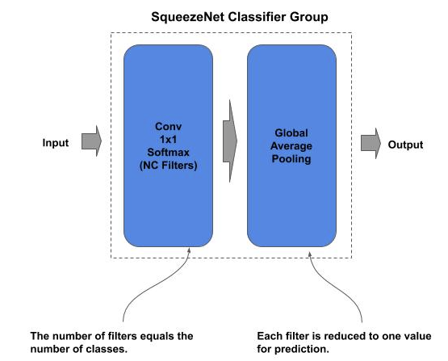
SqueezeNet - Classifier

Slide 33
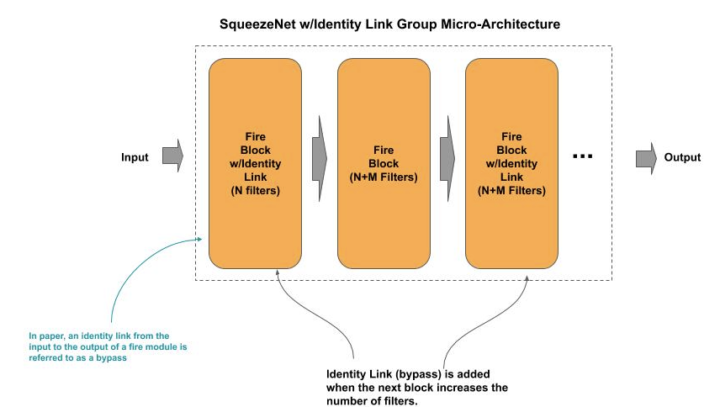
SqueezeNet - Bypass Connections
The authors found by adding bypass connections, they increased the accuracy by 2% (ImageNet).
In the simple bypass, the identity link occurs only in the first fire block (entry into the group) and third fire block (after number of filters has been doubled).

Slide 34
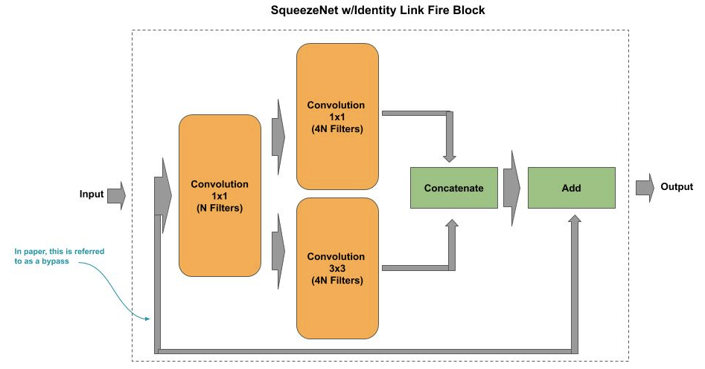
SqueezeNet - Simple Bypass

Slide 35
SqueezeNet - Simple Bypass
Below is an example implementation of a fire block with a simple bypass connection (identity link):
def fire_block(x, n_filters, bypass=False): # remember the input shortcut = x # squeeze layer squeeze = Conv2D(n_filters, (1, 1), strides=1, activation='relu', padding='same')(x) # REMOVED for brevity # concatenate the feature maps from the 1x1 and 3x3 branches x = Concatenate()([expand1x1, expand3x3]) # if identity link, add (matrix addition) input filters to output filters if bypass: x = Add()([x, shortcut]) return x

Slide 36
ShuffleNet V1
ShuffleNet v1 is an architecture introduced by Face++ in 2017. The architecture introduced new layer operations: groupwise point convolutions and channel shuffle.
The authors stated that their design is able to have a large number of feature maps at a substantial reduction in compute costs.
When compared with MobileNet, ShuffleNet achieves superior performance by a significant margin, e.g. absolute 7.8% lower ImageNet top-1 error

Slide 37
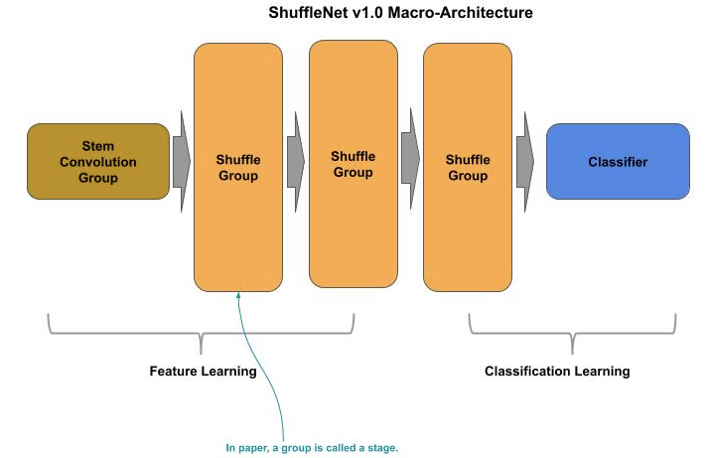
ShuffleNet V1 - Architecture
The architecture consists of three shufflenet groups (referred to as a stage in the paper), where each group doubles the number of output channels (feature maps) from the previous group.

Slide 38
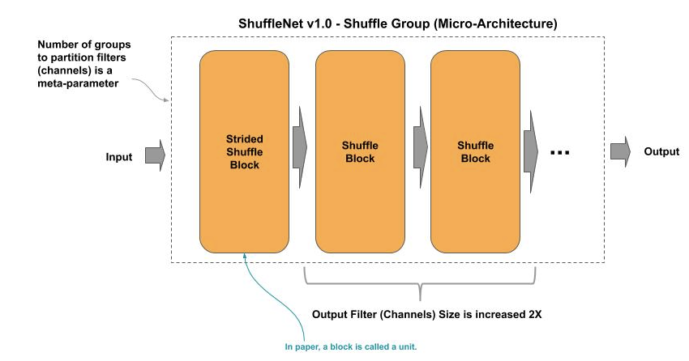
ShuffleNet V1 - Group
Each group in the learner component consists of a strided shuffle block (referred to as a unit in the paper), followed by one or more shuffle blocks. The strided shuffle block doubles the number of output channels while reducing the sizes of each channel by 75%.

Slide 39
ShuffleNet V1 - Group
Below is an example implementation of a shuffle group:
def group(x, n_partitions, n_blocks, n_filters, reduction): ''' Construct a Shuffle Group x : input to the group n_partitions : number of groups to partition feature maps (channels) into. n_blocks : number of shuffle blocks for this group n_filters : number of output filters reduction : dimensionality reduction ''' # first block is a strided shuffle block x = strided_shuffle_block(x, n_partitions, n_filters, reduction) # remaining shuffle blocks in group for _ in range(n_blocks-1): x = shuffle_block(x, n_partitions, n_filters, reduction) return x

Slide 40
ShuffleNet V1 - Block
The shuffle block is based on a B(1, 3, 1) residual block:
The 3x3 convolution is a depthwise convolution (as in MobileNet).
Replaced the 1x1 pointwise convolutions with pointwise group convolutions to reduce computational complexity.
The authors noted that architectures such as Xception and ResNeXt become less efficient in extremely small networks because of the costly dense 1x1 convolutions.

Slide 41
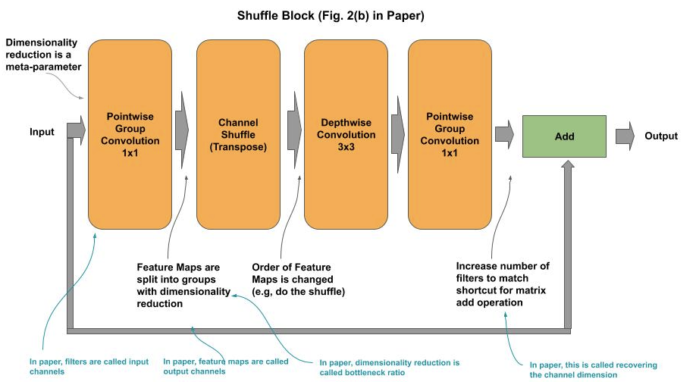
ShuffleNet V1 - Block
The first pointwise group convolution performs a dimensionality reduction on the number of input filters to the block, when the parameter reduction is < 1 (reduction * n_filters), and then it is restored in the output channels with the second pointwise group convolution, for matching the input with the residual for the matrix add operation.
Between the first pointwise group convolution and the depthwise convolution is the channel shuffle operation.

Slide 42
ShuffleNet V1 - Block
Below is an example implementation of a shuffle block:
def shuffle_block(x, n_partitions, n_filters, reduction): # identity shortcut shortcut = x # pointwise group convolution, with dimensionality reduction x = pw_group_conv(x, n_partitions, int(reduction * n_filters)) x = ReLU()(x) # channel shuffle layer x = channel_shuffle(x, n_partitions) # Depthwise 3x3 Convolution x = DepthwiseConv2D((3, 3), strides=1, padding='same')(x) x = BatchNormalization()(x) # pointwise group convolution, with dimensionality restoration x = pw_group_conv(x, n_partitions, n_filters) # Add the identity shortcut (input added to output) x = Add()([shortcut, x]) x = ReLU()(x) return x

Slide 43
ShuffleNet V1 - Block
A example implementation of a pointwise group convolution:
def pw_group_conv(x, n_partitions, n_filters): in_filters = x.shape[-1] # Calculate the number of input filters (channels) # Derive the number of input filters (channels) per group grp_in_filters = in_filters // n_partitions # Derive the number of output filters per group (Note the rounding up) grp_out_filters = int(n_filters / n_partitions + 0.5) # Perform convolution across each channel group groups = [] for i in range(n_partitions): # Slice the input across channel group group = Lambda(lambda x: x[:, :, :, grp_in_filters * i: grp_in_filters * (i + 1)])(x) # Perform convolution on channel group conv = Conv2D(grp_out_filters, (1,1), padding='same', strides=1)(group) # Maintain the point-wise group convolutions in a list groups.append(conv) # Concatenate the outputs of the group pointwise convolutions together x = Concatenate()(groups) x = BatchNormalization()(x) # Do batch normalization of the concatenated filters (feature maps) return x

Slide 44
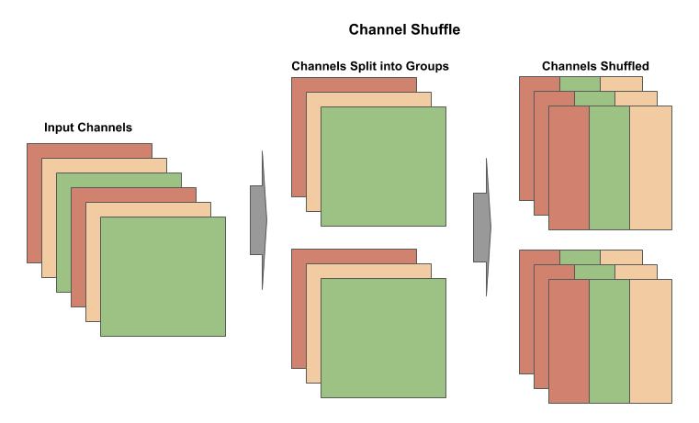
ShuffleNet V1 - Shuffle
Below is a depiction of splitting channels into groups and then shuffling the channels. In essence a shuffle consists of constructing new channels where each shuffled channel has a portion from every other channel -- thus increasing information flow across the output channels.

Slide 45
ShuffleNet V1 - Shuffle
Below is an example implementation of a channel shuffle:
def channel_shuffle(x, n_partitions): # Get dimensions of the input tensor batch, height, width, n_filters = x.shape # Derive the number of input filters (channels) per group grp_in_filters = n_filters // n_partitions # Separate out the channel groups x = Lambda(lambda z: K.reshape(z, [-1, height, width, n_partitions, grp_in_filters]))(x) # Transpose the order of the channel groups (i.e., 3, 4 => 4, 3) x = Lambda(lambda z: K.permute_dimensions(z, (0, 1, 2, 4, 3)))(x) # Restore shape x = Lambda(lambda z: K.reshape(z, [-1, height, width, n_filters]))(x) return x

Slide 46
Quantization
Quantization is a process for reducing the number of bits that represent a number.
For memory constrained devices one would desire that we could store the weights at a lower bit representation without significant loss of accuracy.
Because neural networks are fairly resilient to small errors in calculations, they do not need as high of a precision for inference as needed for training.

Slide 47
Quantization
The conventional reduction is to replace the 32-bit floating point weight values with a discrete approximation as a 8 bit integer values. The primary advantages of this is the reduction from 32 to 8 bits requires only ¼ of memory space for the model.
During inference (prediction), the weights are scaled back to their approximate 32-bit floating point values for the matrix operations which are then passed through the activation function. Modern hardware accelerators have been designed to optimize this rescaling operation that there is nominal compute overhead.

Slide 48
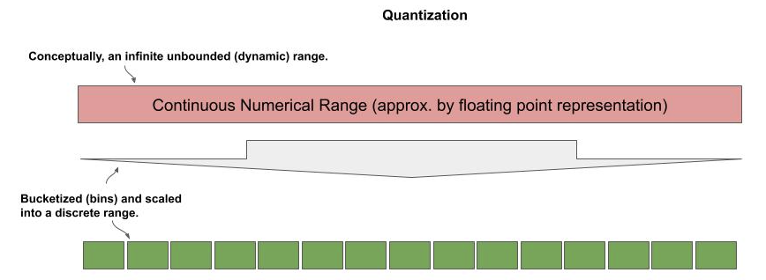
Quantization
In the conventional reduction, the 32-bit floating point weights are divided into buckets (bins) across the integer range. In the case of 8-bit value, this would be 256 buckets.

Slide 49
Quantization - Speedup
Depending on the hardware accelerator, one may additionally see an execution speedup between 2x and 3x on a CPU (and TPU). Integer operations are not supported on a GPU.
For GPU that natively support float16, quantization is done by converting the float32 values to float16. This reduces the model’s memory footprint in half and typically provides a 4x speedup in execution.
Quantization works best when the floating point range of the weights is constrained (shrunk). The current convention for mobile models is to use a max_value of 6.0 for the ReLU for this purpose.

Slide 50
Quantization - Tensorflow Lite - Convert
The code below demonstrates using Tensorflow Lite to quantize an existing model, where model is a trained TF.Keras model.
import tensorflow as tf # Create an instance of the converter for TF.Keras (SavedModel format) model converter = tf.lite.TFLiteConverter.from_saved_model(model) # Convert the model to the TFLite format tflite_model = converter.convert()
One should be careful of quantizing very small models. Large models benefit from the redundancy of weights are very immune to loss of accuracy when quantized to 8-bit integers. The SOTA mobile models have been designed to limit the amount of accuracy loss when quantized. If one designs smaller models and quanitizes them, they may degrade significantly in accuracy.

Slide 51
Quantization - Tensorflow Lite - Interpreter
The TFLite version of the model is not a Tensorflow SavedModel format. You cannot directly use methods like predict(). Instead, one uses the TFlite interpreter. You must first setup the interpreter for the TFLite model as follows:
Instantiate an TFLite interpreter for the TFLite model.
Instruct the interpreter to allocate input and output tensors for the model.
Get detail information about the models input and output tensors that will need to be known for prediction.
# Instantiate an interpreter for the TFLite model interpreter = tf.lite.Interpreter(model_content=tflite_model) # Allocate the input and output tensors for the model interpreter.allocate_tensors() # Get input and output tensors details needed for prediction input_details = interpreter.get_input_details() output_details = interpreter.get_output_details() input_shape = input_details[0]['shape']

Slide 52
Quantization - Tensorflow Lite - Interpreter
The input_details and output_details are returned as a list, where the number of elements corresponds to the number of input and output tensors, respectively.
For example, a model with a single input (e.g., image) and a single output (multi-class classifier) would have one element for both the input and output tensors.

Slide 53
Quantization - Tensorflow Lite - Predict
To make a single prediction, one does the following:
Prepare the input to be a batch of size 1. For our CIFAR-10 example that would be (1, 32, 32, 3).
Assign the batch to the input tensor.
Invoke the interpreter to perform the prediction.
Get the output tensor from the model (e.g., softmax outputs in a multi-class model).
# convert the single input to a batch of size 1. data = np.expand_dims(x_test[1], axis=0) # assign the batch to the input tensor interpreter.set_tensor(input_details[0]['index'], data) # Execute (invoke) the interpreter to perform the prediction interpreter.invoke() # Get the output from the model softmax = interpreter.get_tensor(output_details[0]['index']) # multi-class example, determine the label predicted from the softmax output label = np.argmax(softmax)

Slide 54
Quantization - Tensorflow Lite - Batch
In the case of doing batch prediction, one needs to modify (resize) the interpreter’s input and output tensors for the batch size. The code below resizes the batch size for the interpreter to 128 for a (32, 32, 3) input (i.e., CIFAR-10), prior to allocating the tensors.
# Instantiate an interpreter for the TFLite model interpreter = tf.lite.Interpreter(model_content=tflite_model) # Resize the input and output tensors for batch of 128. interpreter.resize_tensor_input(input_details[0]['index'], (128, 32, 32, 3)) interpreter.resize_tensor_input(output_details[0]['index'], (128, 10)) # Allocate the input and output tensors for the model interpreter.allocate_tensors()

Slide 55
Mobile Networks - Lab Exercise #8
Optional Code Lab - Get Familiar with Mobile Networks
Deep Learning Design Patterns - Workshop - Chapter 4.ipynb

